Slide 1

Computer Science
End Of Studies’ Project
E-Learning Platform for University Teaching
Presented by
SLAOUI Mohamed
BOURRAS Hamza
Supervised by
BOURFIA Youssef

Slide 2
Table Of Content
Introduction
General Problem
Technology Tools
Project Conception
Project Implementation
Conclusion

Slide 3
Introduction

Slide 4

The Problem
Inefficient communication methods between students and professors
Security issues and difficulties in submitting assignments
Absence of interactive learning tools

Slide 5








Used Tools
React JS
Laravel
MySQL
XAMPP
Redux
VS Code
Tailwind CSS
Postman

Slide 6
Project Conception

Slide 7
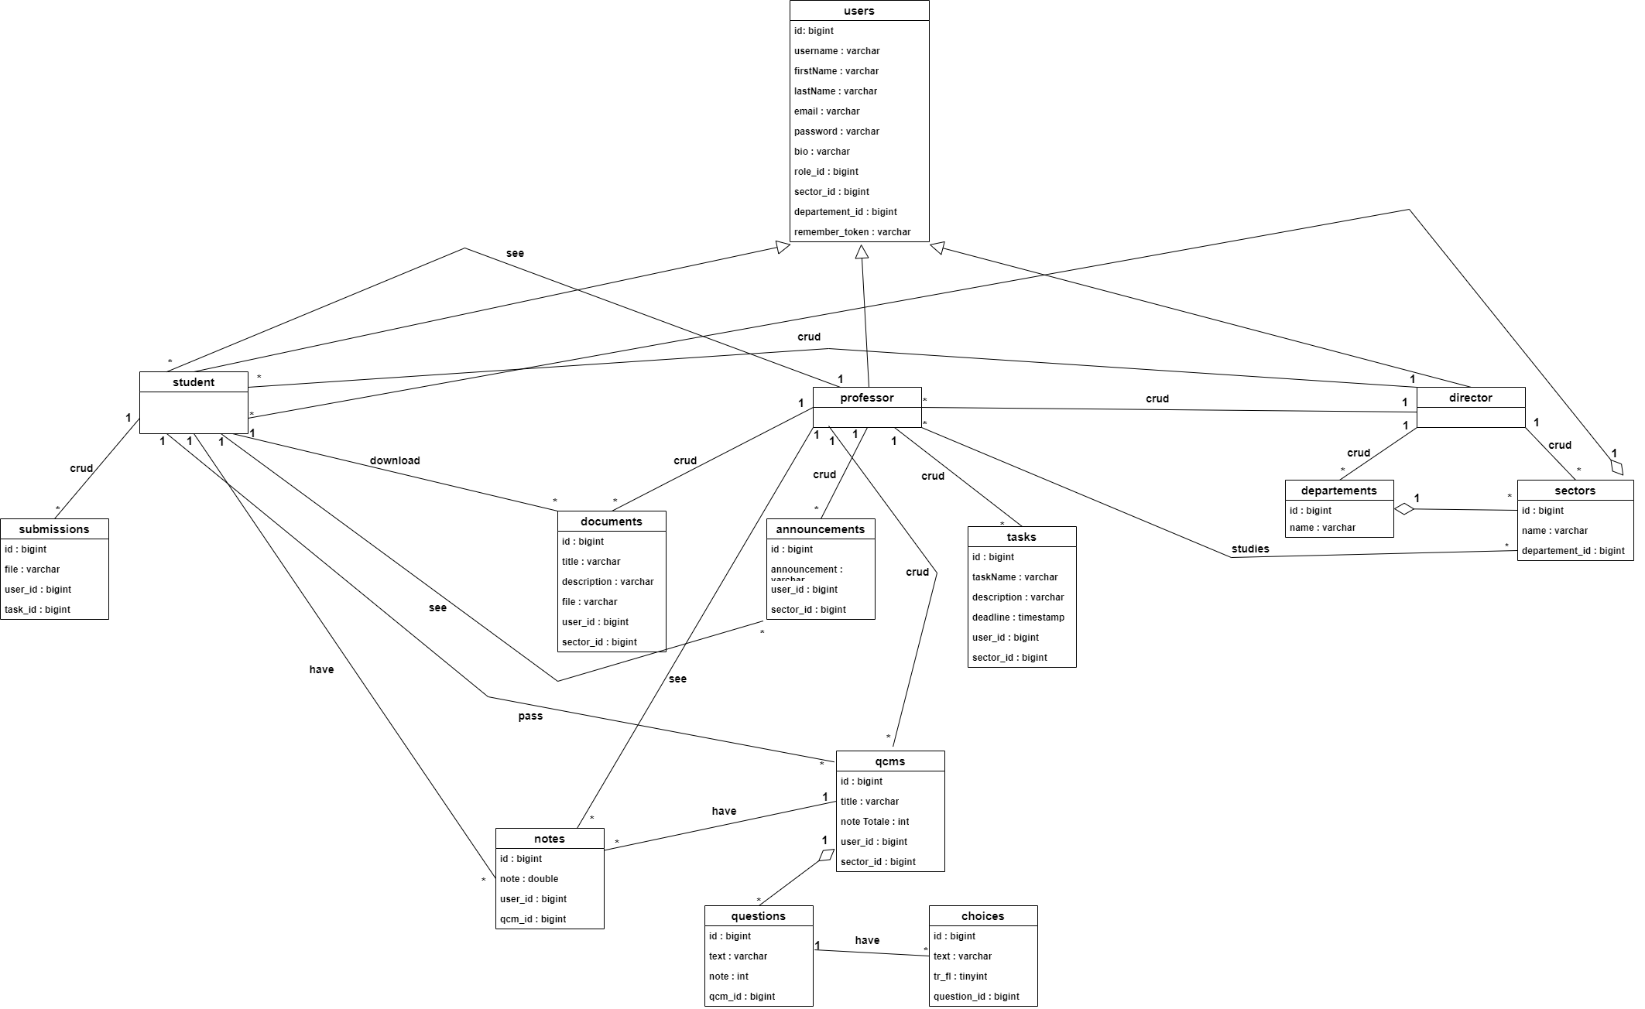
Class Diagram

Slide 8
Project Implementation

Slide 9
Conclusion

Slide 10
Thank you!

